Slide 1
Lecture 3
22-3-2024

Slide 2
Statistics
Area of applied mathematics concerned with the data collection, analysis, interpretation and presentation.
For example; Business sales report

Slide 3
Sampling
It is a statistical method that deals with the selection of individual observations with in a population.
To understand different statistics about the population like mean, median, standard deviation or variance, then we have to perform sampling.
Example; Eating habits of teenagers in the US.

Slide 4
Basic terminologies in statistics
Population → A collection or set of individuals, whose properties are to analyzed.
Sample → A subset of population is called as “Sample”. A well-chosen sample will contain most of the information about a particular population.

Slide 5
Types of Sampling technique
Probability → Random, Systematic, Stratified
Non-probability → Snowball, Quota, Judgement, Convenience

Slide 6
Probability Sampling
It is a sampling technique in which samples from a large population are chosen by using the theory of probability.

Slide 7
1. Random Sampling
Each member of the population has an equal chance of being selected in the sample.
Means each member is selected randomly from the population to become a part of a sample.

Slide 8
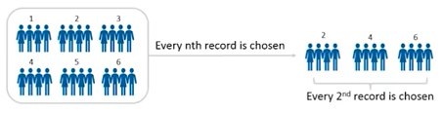
Systematic sampling
In this sampling, every nth record is chosen from the population to be a part of the sample.

Slide 9
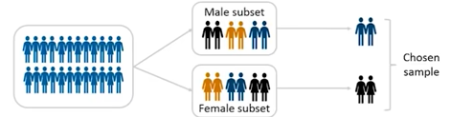
Stratified sampling
In this sampling, a stratum is used to chose a sample from a large population.
A stratum is a subset of the population that shares at least one common characteristics eg; gender.
Then we use random sampling, to select a sufficient number of subjects from each stratum.

Slide 10
Measure of Spread
Also known as measure of dispersion, is used to describe the variability in a sample or a population.
Different spread are defined as,
Range
Inter-Quartile Range
Variance
Standard Deviation

Slide 11
Range
It is the given measure of how spread apart the values in the dataset are;
Formula = Max(x) – Min(x)

Slide 12
Inter-Quartile Range(1)
Quartile tells us about the spread of a dataset by breaking the datasets into quarters (similar to median)
For example; we have 100 students marks in ascending order.
We make different quarters i.e. 3 quartiles
Quartile – 1 : 25th & 26th student marks → (45+45)/2 = 45
Quartile – 2 : 50th & 51st student marks → (58+59)/2 = 58.5
Quartile – 3 : 75th & 76th student marks → (71+71)/2 = 71

Slide 13
Inter-Quartile Range(2)
Inter Quartile Range (IQR) is the measure of variability, based on dividing a dataset into quartiles.
The IQR is equal to Q3 minus Q1 i.e. IQR = Q3 – Q1.

Slide 14

Variance
It describe how much a random variable differs from its expected value.
Formula to calculate variance;
Here,
x : individual data points
n: total number of data points
x : mean of the data points

Slide 15

Standard Deviation
It is the difference between each element from the mean.
What is SD of these 6 numbers 20, 13, 17, 9, 28, 3 ?
Notes:
Calculate the mean (average)
Calculate the squared difference (num – mean) power 2
Calculate the mean of the squared differences.
Take the square root of the mean of the squared differences.

Slide 16

Entropy
It measures the impurity or uncertainty present in the data.
where,
S → set of all instances in the dataset
N → number of distinct class values
pi → event probability

Slide 17

Information Gain
Indicates how much information a particular feature/variable gives us about the final outcome.

Slide 18
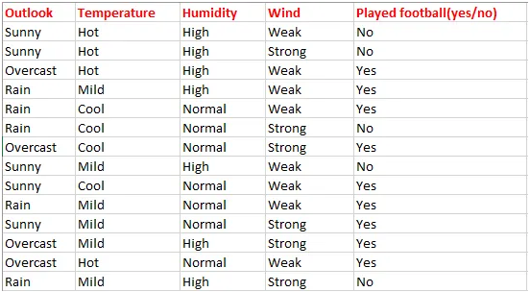
Use Case
Forecast whether the match will be played or not according to weather conditions.

Slide 19
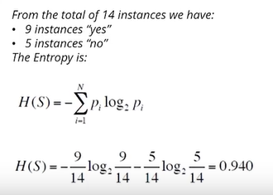
1. Find the entropy of class variables

Slide 20
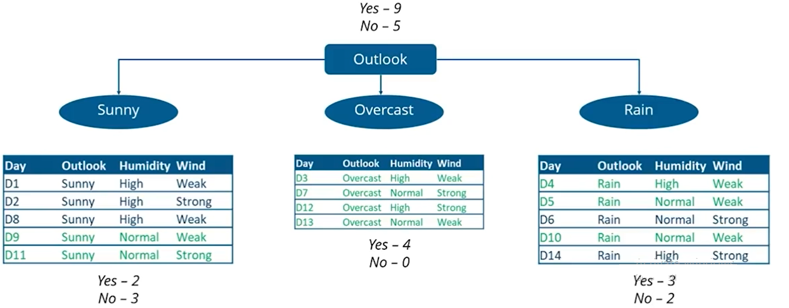
Overview of the Predictor Variable

Slide 21
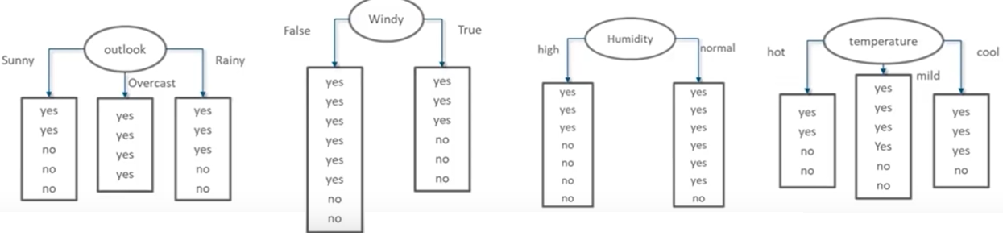
Selecting the root node

Slide 22
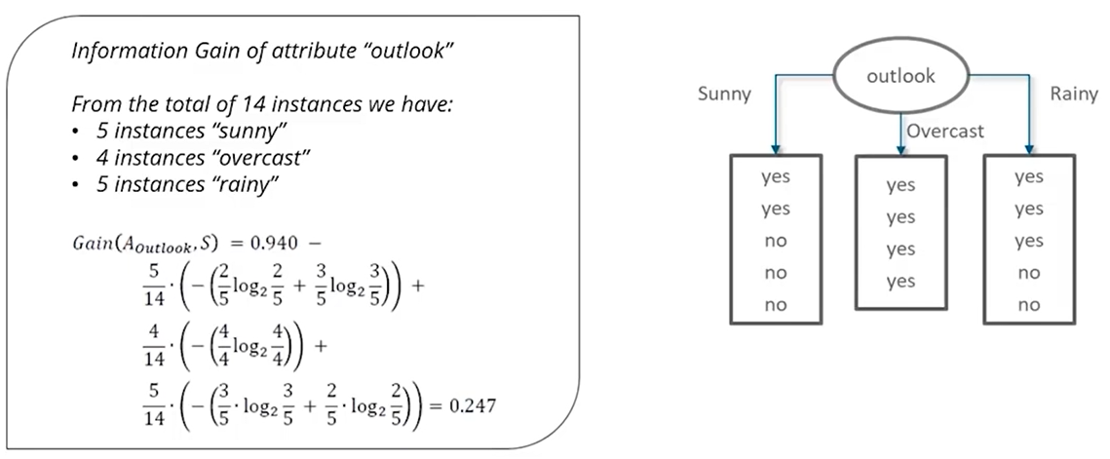
IG - Outlook

Slide 23
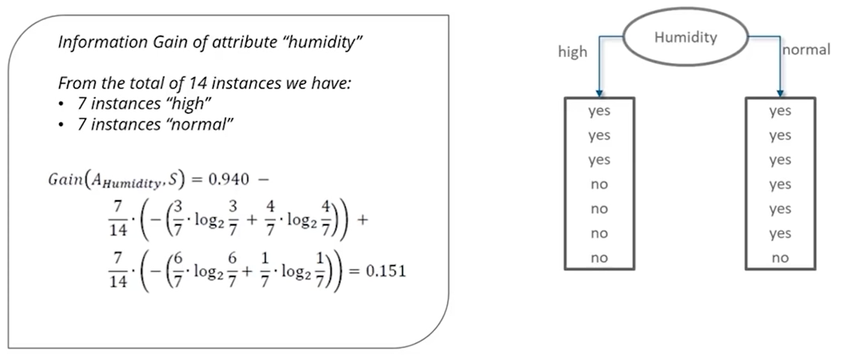
IG - Humidity

Slide 24
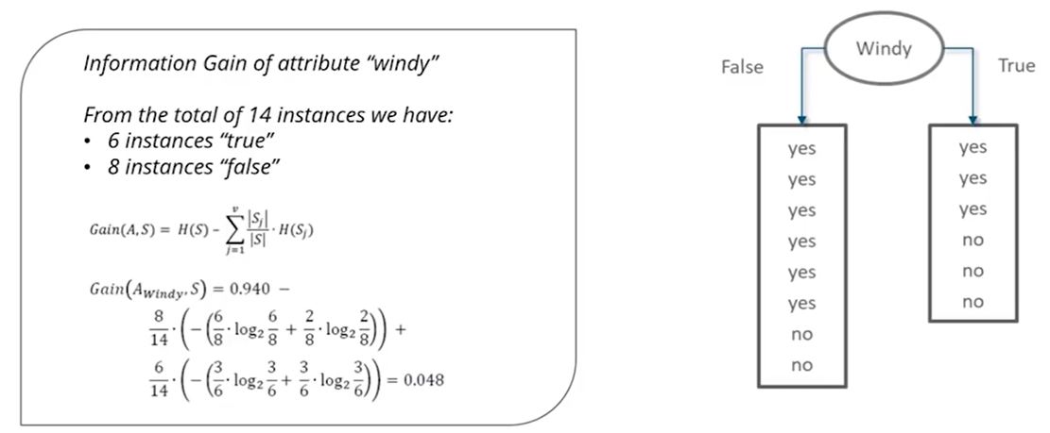
IG - Windy

Slide 25
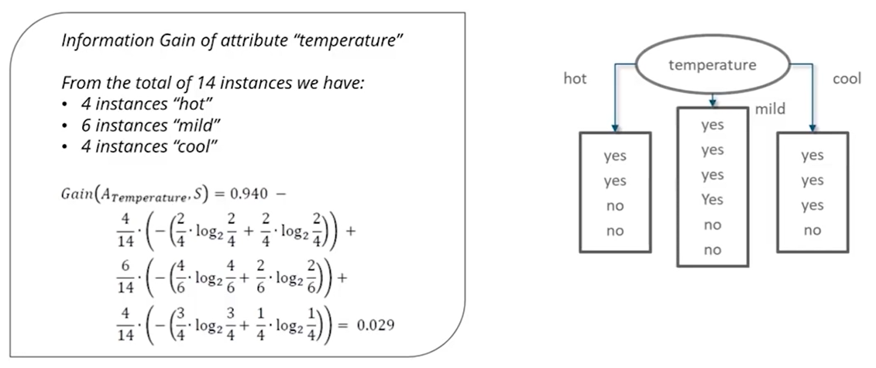
IG - temperature

Slide 26
Highest Information Gain
Outlook → 0.247
Humidity → 0.151
Windy → 0.048
Temperature → 0.029
The node with the highest Information Gain (IG) will be chosen as a root node for decision trees.

